Slide 1
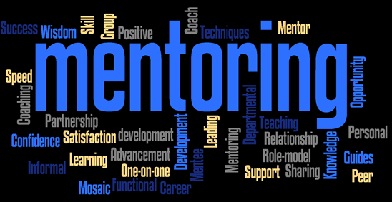
https://slproductions.wordpress.com/

Slide 2
Role Model, Mentor, or Friend?
Presented by Nancy J. Easterly
PTRA (Physics Teaching Resource Agent)
Lone Star College – Greenspoint
nj.easterly@nsyt.com

Slide 3
http://ih3.redbubble.net/image.14230868.8437/flat,550x550,075,f.u1.jpg

Slide 4
According to the National Center for Education Statistics
Approximately 33% leave teaching after 3 years
Approximately 46% are gone after 5 years

Slide 5
Hired over the backyard fence

Slide 6
Can we get rid of her?

Slide 7
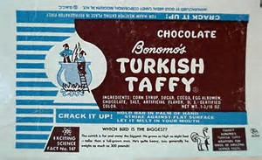

Slide 8
The historical aspect of Mentoring
Mentor, the teacher of Telemachus, son of Odysseus, from Homer’s Odyssey.

Slide 9
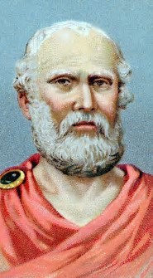
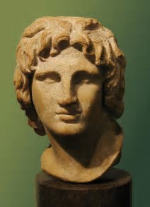
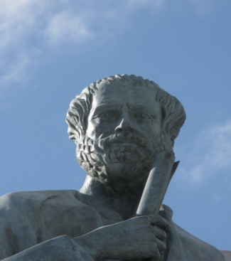
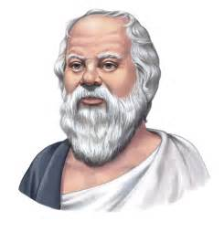
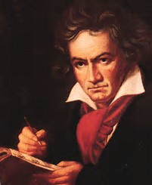
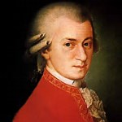
Aristotle
Alexander the Great
Socrates
Plato
Haydn
Beethoven

Slide 10
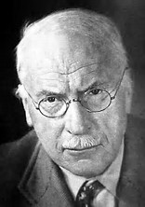
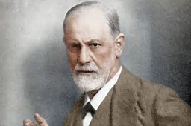
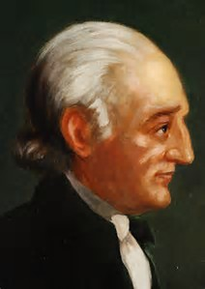
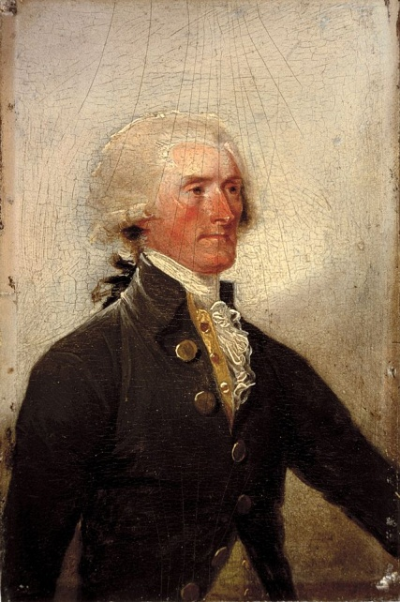
Mentor: trusted advisor, friend, teacher and wise person.
Freud
Jung
George Wythe
Thomas Jefferson

Slide 11
Mentoring is a fundamental form of human development where one person invests time, energy and personal know-how in assisting the growth and ability of another person. Mentors help us reach our full potential.

Slide 12
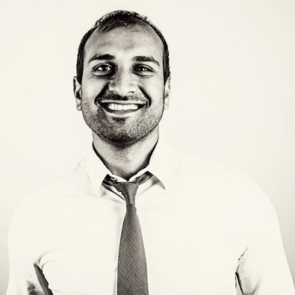
Sujan Patel, co-founder of Web Profits, a growth marketing agency. His company uses the latest and greatest marketing strategies to build and fuel other businesses

Slide 13
Why people avoid mentoring relationships
They do not know where to start.
They are too proud to ask for help.
They believe it is a waste of time.

Slide 14
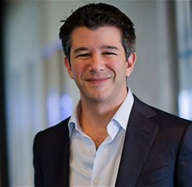
Too Proud, Waste of time?
Travis Kalanick, CEO of Uber

Slide 15
Mentoring is a Two Way Street
Mentees
Mentors
Need to have clear objectives
Have a willingness to receive feedback
Want to focus on their professional growth.
Desire to coach, support and help the mentee reach his/her full potential
Great mentors will have empathy or the ability to place oneself in their mentee’s position.

Slide 16
Mentors Also
Should not impose their values on the mentee.
Know what the mentee wants in a career, as well as what he/she wants for their personal lives and how the two inter-relate
Realize how the mentee’s background may differ from his/her own
Should listen closely– this is probably the most important trait in a mentor. Do not try to “fix things”, without consideration for the mentee’s needs.

Slide 17
Movie Mentors
Obi Wan and/or Yoda from Stars Wars
Professor X from X-men
Mickey Goldmill from Rocky
Mr. Miyagi From Karate Kid
Splinter from Ninja Turtles
Dumbledore from Henry Potter
Gandalf from the Hobbit
Mufasa from the Lion King
Mary Poppins
Morgan Freeman in Belle Island and a multitude of other movies is probably the most mentioned actor playing a role as a mentor.

Slide 18
Biblical Mentors
Jethro mentoring Moses
Moses mentoring Joshua and the elders of Israel
Eli mentored Samuel (even though Eli didn’t do a very good job with his own sons.)
Samuel mentors Saul and David.
Elijah mentors Elisha
Jesus Mentors the 12 apostles

Slide 19
Proverbs 27:17
Iron sharpens iron; so a man sharpens the countenance of his friend.

Slide 20
AAPT has an eMentoring program.
The AAPT eMentoring program is designed to connect AAPT members with the K-12 educator community.

Slide 21
AAPT’s E-mentoring Program
Go to the AAPT.org website. Find the K-12 portal tab and click on eMentoring.

Slide 22
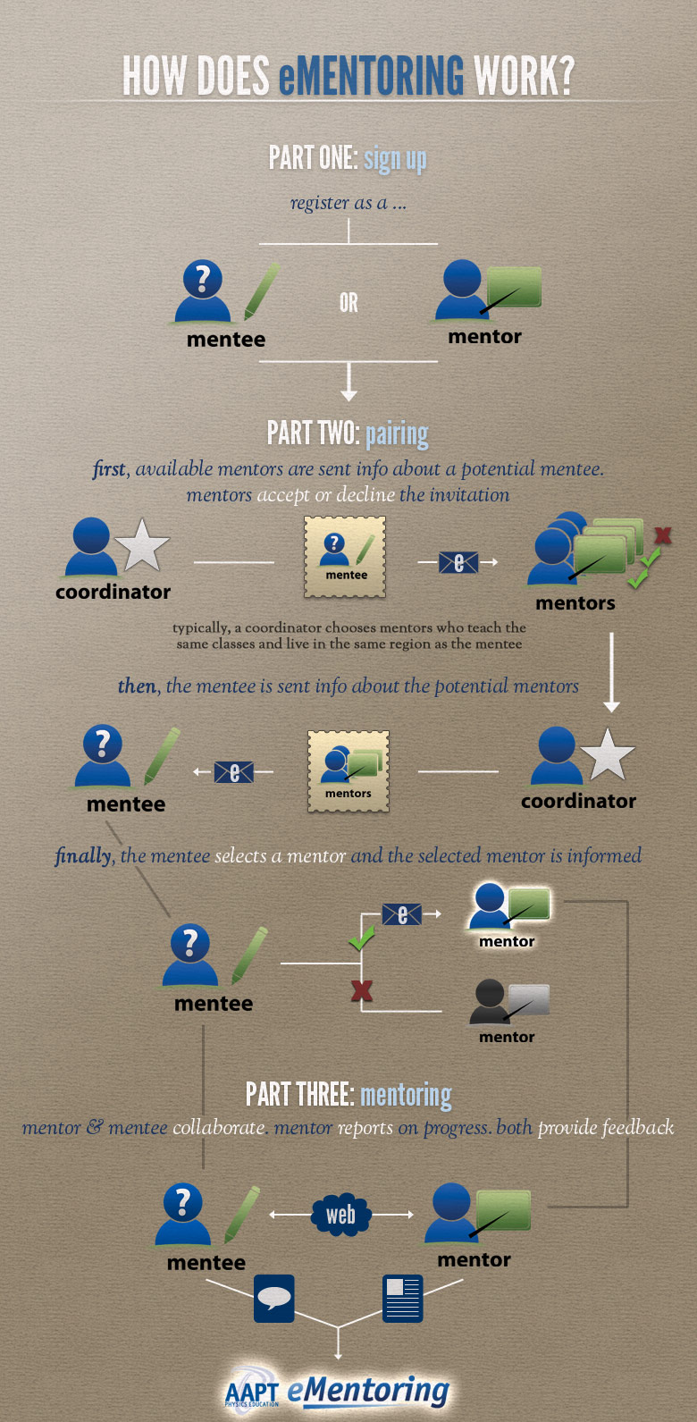

Slide 23
My AAPT Mentoring Experience
I have had somewhere between 12-18 mentees.
At one time I had 6 mentees, but none were super demanding
Most of my mentees were from my home state, Texas,
I did mentor one from Brazil during our summer, but their school year. He was educated here, and returned to Brazil to teach.
Remember physics is physics no matter what the language, even though our students often think it is γρεεκ!! (greek)

Slide 24
Does Mentoring Matter?
Findings of a multi-year study on the effects of mentoring in the workplace followed the career progress of approximately 1,000 employees over a 5-year period and found that, “employees who received mentoring were promoted FIVE times more often than people who didn’t have mentors,” and “Both mentors and mentees were approximately 20% more likely to get a raise than people who did not participate in the mentoring program.”

Slide 25
Dedicated to Edwin Paul Heideman
Physics Teacher, extraordinaire, Pleasantville High School, Pleasantville, New York.
Thanks for making physics “magical”.

Slide 26
Thank you
Presented by Nancy J. Easterly
PTRA (Physics Teaching Resource Agent)
Lone Star College – Greenspoint
nj.easterly@nsyt.com

